Slide 1


Resilient PNT Update – U.S.A.
January 2015
RPNT Forum II, Dana Point, CA

Slide 2


“…a single point of failure…”

Slide 3




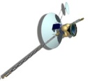
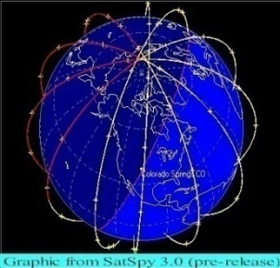




Critical Infrastructure GPS Dependencies
ATM Networks
Stock Exchanges
Energy Plants
Substations
Internet Banking
Power Grids
Banks/ Nodes
GPS Time
GPS Time
  GPS Supporting Power Grid Systems
  GPS Supporting Banking Operations
GPS
GPS Time &
Position
GPS Time &
Position
Rail Yards
Switching Towers
& Signals
Wireless
Internet
C² Centers
Comms
Networks
Air Traffic Control
Access
GIS / Map
Relay Position
To 911 Dispatch
Ship Routing
  GPS Supporting Transportation Systems
  GPS Supporting Communications Systems
GPS Critical Infrastructure Timing Study: Usage/Loss Impacts/Backups/Mitigation
James Caverly, NPPD (DHS) 2007
Notes:
3
3
UNCLASSIFIED//FOR OFFICIAL USE ONLY
UNCLASSIFIED//FOR OFFICIAL USE ONLY
3

Slide 4

US Mandate for Action
“Acquire a GPS
Backup …”
NSPD-39
December 15, 2004
RNT Fnd | Jan 2015

Slide 5

Selected Technology - eLoran
High Power (400kw xmitter)
Low Frequency (100 kHz)
Penetrates:
  Indoors
  Underwater
  Underground
February 2008
RNT Fnd | Jan 2015

Slide 6















RNT Foundation
International Membership
Poland
Netherlands
Norway
Egypt
United Kingdom
Australia
Canada
Switzerland
United States
RNT Fnd | Jan 2015

Slide 7

US Congress Concerned
‘When space is not available – what’s the plan?”
Public Law 113-66
Defense Authorization Act for 2014
RNT Fnd | Jan 2015

Slide 8
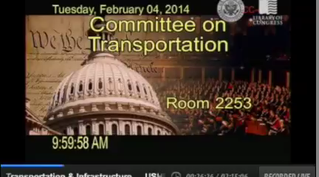
US Congress Concerned
RNT Fnd | Jan 2015

Slide 9
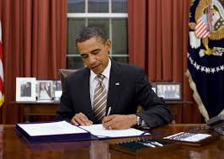
US Law – 18 December 2014
Preserve Loran infrastructure
for possible re-use
Government may enter
into a Cooperative Agreement with
a public or private entity
to build eLoran
S.2444, Howard Coble US Coast Guard Authorization Act of 2014
RNT Fnd | Jan 2015

Slide 10



Administration Concerned
“We have known about the problem since 2001.”
Dept. of Transportation Deputy Secretary
“Interested in eLoran as part of APNT.”
Dept. of Defense CIO
“Precise, synchronized time is a real problem.”
Dept. of Homeland Security Senior Official
RNT Fnd | Jan 2015

Slide 11

“I Hate GPS”
Secretary of Defense Nominee – Ashton Carter

Slide 13
US Army – “How much for 50,000 eLoran Receivers?”
FedBizOpps.Gov
14 Jan 2015
RNT Fnd | Jan 2015

Slide 14

What Can You Do?
Understand
RNT Fnd | Jan 2015

Slide 15

What Can You Do?
Understand
Educate
RNT Fnd | Jan 2015

Slide 16



What Can You Do?
Understand
Educate
RNT Fnd | Jan 2015

Slide 17

What Can You Do?
Understand
Educate
Support
RNT Fnd | Jan 2015

Slide 18
www.RNTFnd.org
RNT Fnd | Jan 2015

