Slide 1
Resilient PNT Update in Europe
Martin Bransby
Research and Radionavigation (R&RNAV)
General Lighthouse Authorities (GLA) of the United Kingdom and Ireland
Resilient PNT Forum, Dana Point, CA
26th January 2015

Slide 2
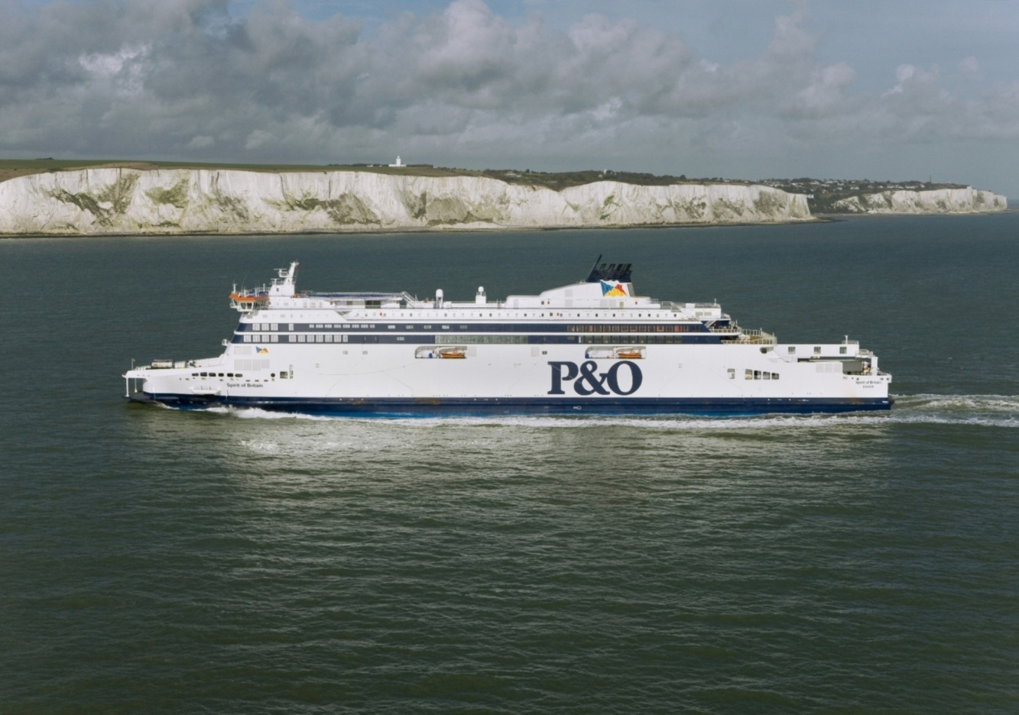
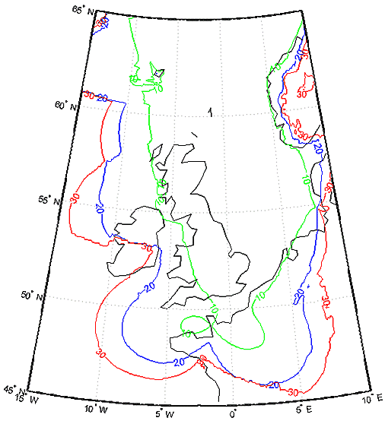
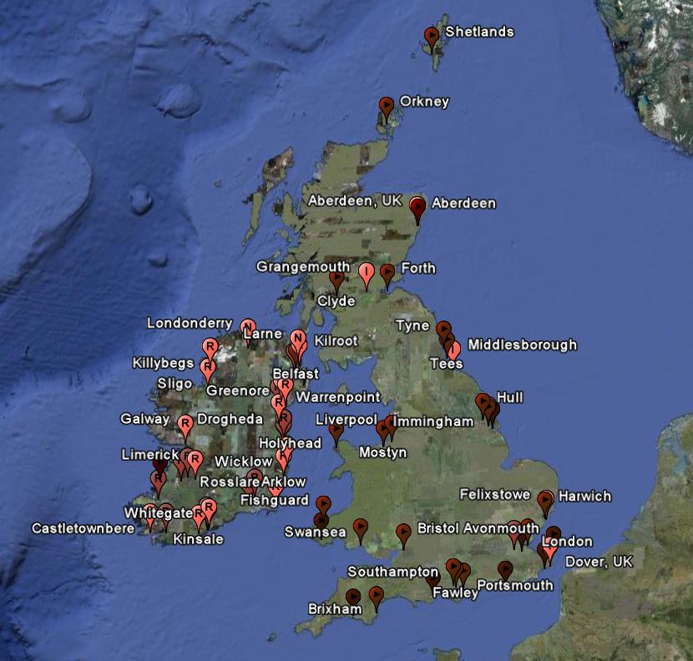
eLoran Initial Operational Capability
  7 major east coast ports
  formally declared 31 October 2014

Slide 3
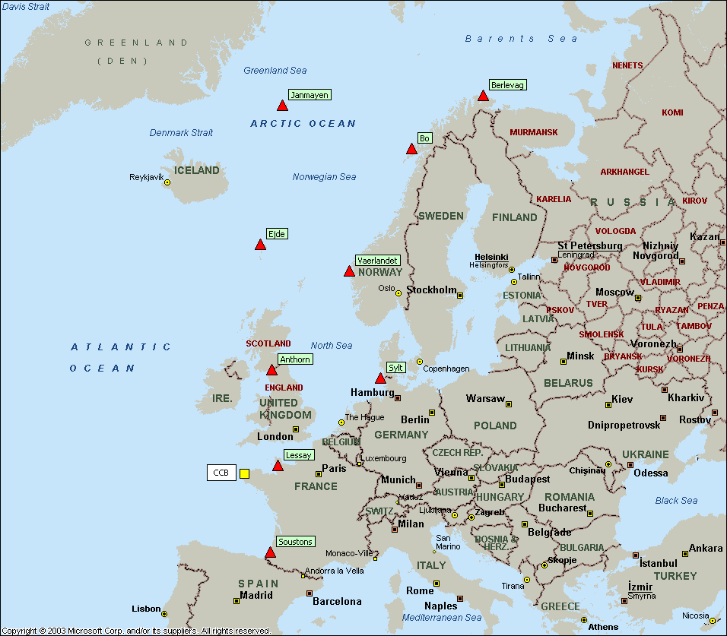
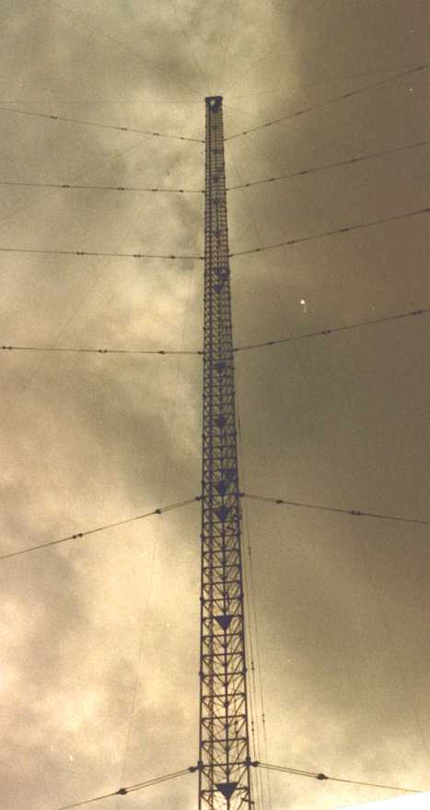
Current (e)Loran in Europe
9 transmitters on air
France 2
- Lessay, Soustons
UK 1 - Anthorn
Denmark (Faeroes) 1
- Ejde
Germany 1 - Sylt
Norway 4
- Vaerlandet, Boe
- Jan Mayen, Berlevåg
NW Europe region: Coordinated by France
Administered by Control Centre Brest (CCB)

Slide 4
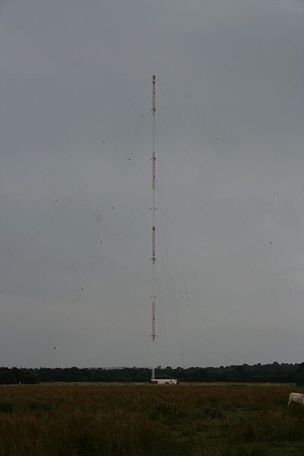
Decision by French Navy
  “French Navy is about to end Loran-C broadcasts by the end of 2015”
  “GNSS back up for maritime sector, such as eLoran, is not a priority for the French Maritime Directorate”
  “French Maritime Directorate will no longer keep in operation the French Loran-C infrastructure”
  “Furthermore be aware of dismantle (sic) of French installations (including Soustons and Lessay Loran-C stations and the Brest Loran-C Control Centre) in 2016”
  “ By the end of 2015, the French Maritime Directorate will also stop its support in [Faroe Islands] Loran-C station”

Slide 5
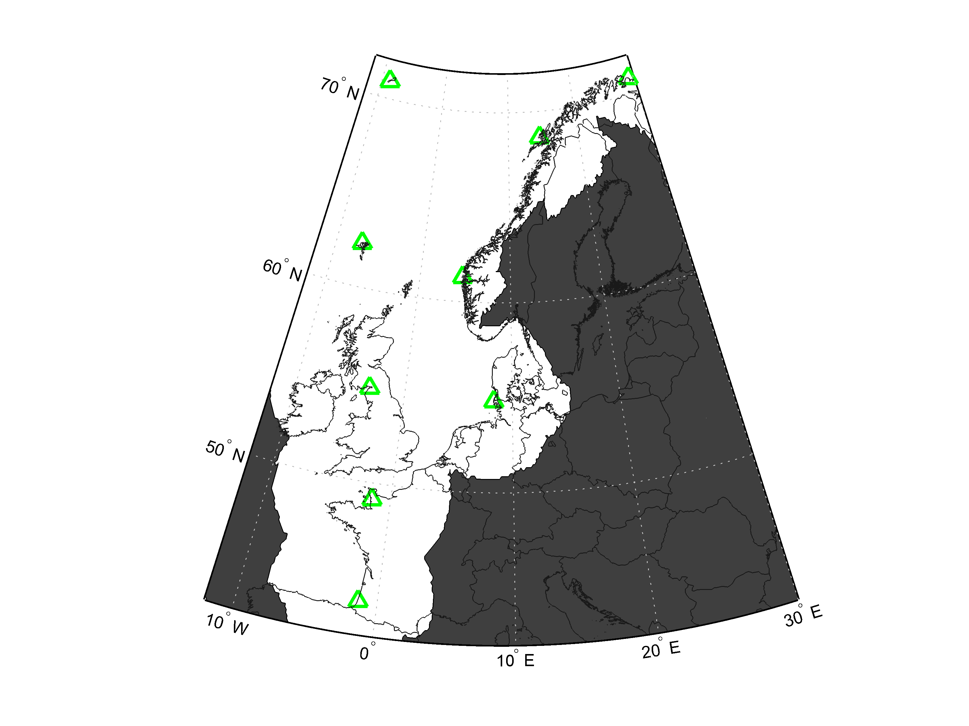
A commercial future for eLoran?
GLA are supporting industry initiatives to explore operating eLoran as a commercial entreprise across Europe
  Babcock International, DCNS, UrsaNav, Chronos Technology…
  Business model is challenging - requires collaboration and long term (10 years +) contracts and commitments
  Must be attractive for existing Administrations (UK, France, Germany, Denmark especially)
  Leading commercial opportunity is precision timing for telecoms, also…
    land mobile positioning (e.g. land/sea integrated logistics)
    smart power grid distribution (identified by US as CNI with greatest vulnerability)
eLoran 500ns timing coverage indoors

Slide 6
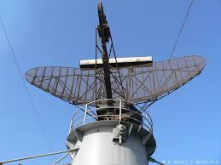
Complementary approaches to maritime Resilient PNT
R-Mode (Ranging Mode) on radio-beacon MF DGPS broadcasts and VHF AIS
  feasibility study completed
  technical demonstration soon
  regulatory process not started yet
  potential integration with eLoran
Radar absolute positioning
  trial complete with good results
  limited effective range
  no backup for ‘T’
  introduction would take decades
Maritime focus with fewer cross-sector benefits
Technology less mature and less capable
More extensive shore infrastructure – higher cost
Longer regulatory timescales – beyond introduction of e-Navigation
Greater complexity and costs of ship equipage
Image credit: Acid.org

Slide 7
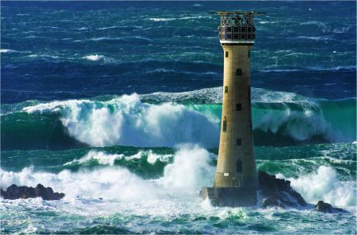
Thank You
Image credit: Tim Harvey
For more information contact:
Martin.bransby@gla-rrnav.org
Tel: +44 (0)1255 245042
Cell: +44 (0)7770 265652

